Slide 1
Html notes
My observations

Slide 2
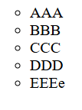
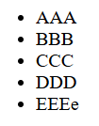
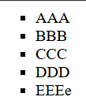
AAA
BBB
CCC
DDD
EEEe
<html>
<head>
<title>25th Sept</title>
</head>
<body>
<ul style = "list-style-type: circle">
<li>AAA</li>
<li>BBB</li>
<li>CCC</li>
<li>DDD</li>
<li>EEEe</li>
</ul>
</body>
</html>
Bold circle
filled circle
Square
Seems to be only filled ?

Slide 3
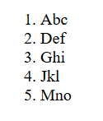
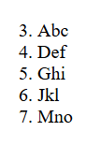
Slide no. 31
Without a start attribute; so default is 1
Start = 3 or “3” both works
<html>
<head>
<title>25th Sept</title>
</head>
<body>
<ol style = "list-style-type: decimal"start = "3">
<li>Abc</li>
<li>Def</li>
<li>Ghi</li>
<li>Jkl</li>
<li>Mno</li>
</ol>
</body>
</html>
In style, after = it is within quotes. Attribute: value pair

Slide 4
<html>
<head>
<title>25th Sept list</title>
</head>
<body>
<ul>
<li>Abc</li>
<li>Def</li>
<li>Ghi</li>
<li>Jkl</li>
<li>Mno</li>
</ul>
</body>
</html>

Slide 5
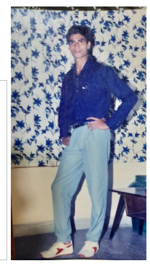
<img src = "akg.jpg" width ="150 height = "200">
<img
src="https://upload.wikimedia.org/wikipedia/commons/e/ef/Virat_Kohli_during_the_India
_vs_Aus_4th_Test_match_at_Narendra_Modi_Stadium_on_09_March_2023.jpg"
width="100" height="100">

Slide 6
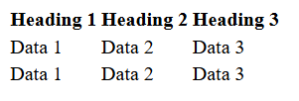

Depending upon the size of the heading, the fields will be properly aligned automatically
<html>
<head> <title> Making Table</title> </head>
<body>
<table>
<tr>
<th>Heading 1</th>
<th>Heading 2</th>
<th>Heading 3</th>
</tr>
<tr>
<td>Data 1</td>
<td>Data 2</td>
<td>Data 3</td>
</tr>
<td>Data 1</td>
<td>Data 2</td>
<td>Data 3</td>
</tr>
</table>
</body>
</html>

Slide 7
<html>
<head> <title>25th Sept</title> </head>
<body>
<table>
<tr> <th>Heading 1</th><th>Heading 2</th><th>Heading 3</th></tr>
<tr> <td>Data 1</td> <td>Data 2</td> <td>Data 3</td> </tr>
<tr> <td>Data 1</td> <td>Data 2</td> <td>Data 3</td> </tr>
</table>
</body>
</html>

Slide 8
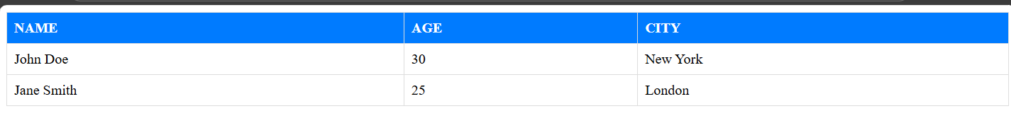
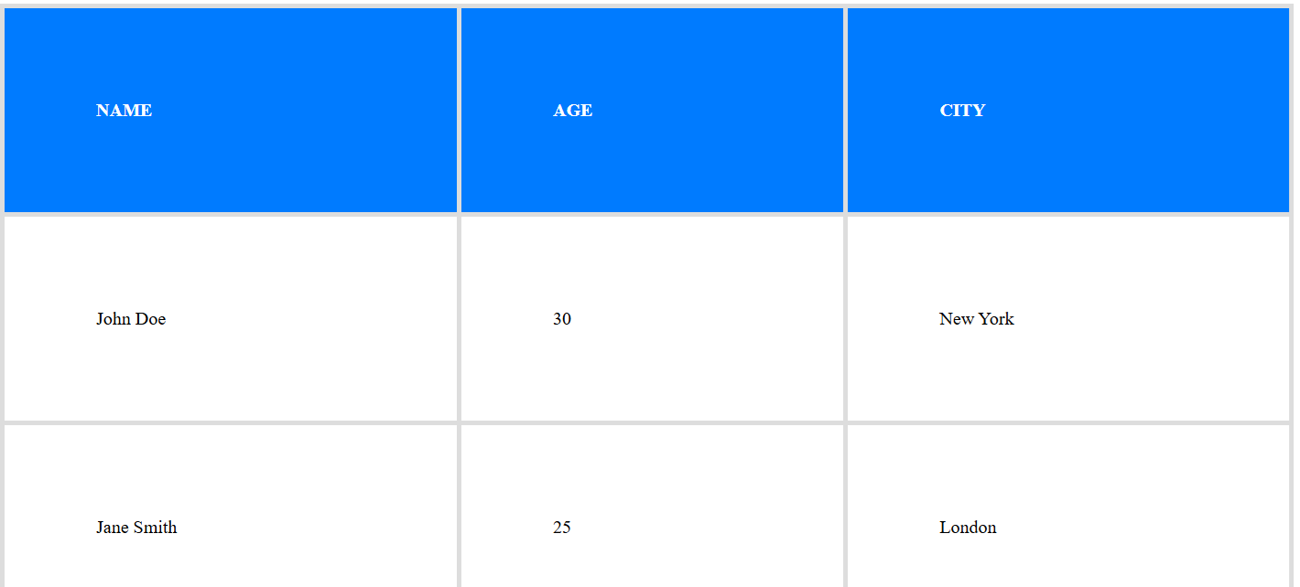

<html>
<head>
<style>
table{
width: 100%;
border-collapse: collapse; /* Removes space between cell borders */
}
th, td {
border: 1px solid #ddd;
padding: 8px;
text-align: left;
}
th {
background-color: #007bff; /* Blue background for headers */
color: white; /* White text for headers */
font-weight: bold;
text-transform: uppercase;
}
</style>
</head>
<body>
Decides the border thickness of cells
<table>
<tr>
<th>Name</th>
<th>Age</th>
<th>City</th>
</tr>
<tr>
<td>John Doe</td>
<td>30</td>
<td>New York</td>
</tr>
<tr>
<td>Jane Smith</td>
<td>25</td>
<td>London</td>
</tr>
</table>
</body>
</html>
Decides the depth of cells

Slide 9
Image tag
<html>
<head>
<title>25th Sept</title>
</head>
<body>
<img
src="https://upload.wikimedia.org/wikipedia/commons/e/ef/Virat_Kohli_during_the_India
_vs_Aus_4th_Test_match_at_Narendra_Modi_Stadium_on_09_March_2023.jpg"
width="100"
height="100">
<img src="img1.png" width="200" height="200">
</body>
</html>

Slide 10
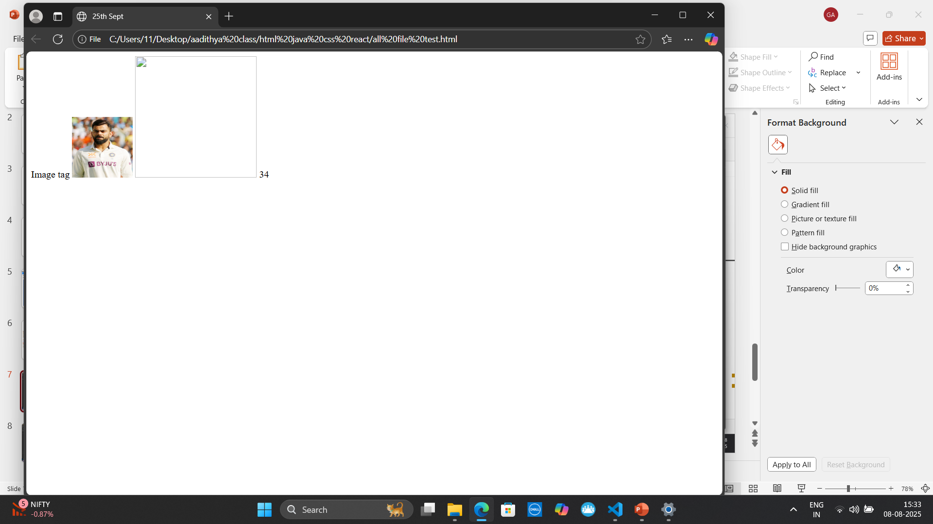

Slide 11
<html>
<body>
div tag
a. Used as a section or section in the HTML document
b. Example:
form tag
c. A form is used to create an HTML form for user input
d. A form can have these in it:
i. <input>
ii. <textarea>
iii. <button>
iv. <select>
v. <option>
vi. <optgroup>
vii. <fieldset>
viii. <label>
</body>
</html>
Add all the options for each of these fields form the phone file

Slide 12
Button <button type="submit" onclick="alert('Form submitted!')">Submit Form</button> Input <input type="value" name="input_name" id="input_id" value="default_value" placeholder="hint_text">

Slide 13
Text area <textarea name="uniqueName" id="uniqueId" rows="number" cols="number" placeholder="Hint text" maxlength="number" minlength="number" readonly disabled required autofocus form="formId" wrap="soft|hard" dirname="name.dir" > Default content or pre-filled text </textarea>

Slide 14
Select <select id="mySelect" name="myDropdown"> <option value="">--Please choose an option--</option> <option value="option1">Option 1 Display Text</option> <option value="option2">Option 2 Display Text</option> <option value="option3" selected>Option 3 Display Text (Selected by default)</option> <optgroup label="Grouped Options"> <option value="groupOption1">Grouped Option 1</option> <option value="groupOption2">Grouped Option 2</option> </optgroup> </select>

Slide 15
Option <option value="value_to_send">Text displayed to user</option> Optgroup <select> <optgroup label="Group Label 1"> <option value="value1">Option 1.1</option> <option value="value2">Option 1.2</option> </optgroup> <optgroup label="Group Label 2"> <option value="value3">Option 2.1</option> <option value="value4">Option 2.2</option> <option value="value5">Option 2.3</option> </optgroup> <option value="value6">Ungrouped Option</option> </select>

Slide 16
Field set <fieldset> <legend>Fieldset Title</legend> <!-- Form elements go here --> <label for="input1">Input 1:</label> <input type="text" id="input1" name="data1"> <br><br> <label for="select1">Select Option:</label> <select id="select1" name="option_selection"> <option value="optionA">Option A</option> <option value="optionB" selected>Option B (pre-selected)</option> <option value="optionC" disabled>Option C (disabled)</option> </select> <br><br> <input type="checkbox" id="checkbox1" name="agree" checked> <label for="checkbox1">Agree to terms</label> <br><br> <input type="radio" id="radio1" name="choice" value="choice1"> <label for="radio1">Choice 1</label> <input type="radio" id="radio2" name="choice" value="choice2" checked> <label for="radio2">Choice 2</label> <!-- Other form elements like textarea, buttons can also be included --> </fieldset>

Slide 17
<label for="element_id">Label Text</label> ######$$$$############# Common type attribute values: text: Single-line text input. password: Password input (characters are masked). email: Email address input (includes basic client-side validation). number: Numeric input (allows min, max, and step attributes). checkbox: Checkbox for selecting multiple options. radio: Radio button for selecting a single option from a group. submit: Button to submit the form. button: Generic clickable button. file: File upload control. date: Date selection control. color: Color picker. range: Slider control for a numeric range. search: Search input field. tel: Telephone number input. url: URL input (includes basic client-side validation). hidden: Hidden input field (not visible to the user). Important Attributes applicable to various types: name: Defines the name of the input field, used for submitting data. id: Provides a unique identifier for the input, useful for labels and JavaScript. value: Sets the initial value of the input or the value sent upon submission. placeholder: Provides a hint to the user about the expected input value. required: Makes the input field mandatory for form submission. disabled: Disables the input field, making it uneditable and unsubmitable. readonly: Makes the input field uneditable but still submitable. min / max: Specifies minimum/maximum values for numeric or date/time inputs. step: Defines the increment for numeric or date/time inputs. autocomplete: Controls browser's autofill behavior. autofocus: Automatically focuses on the input when the page loads. pattern: Specifies a regular expression for input validation. size: Specifies the visible width of the input in characters (for text-based types). maxlength: Specifies the maximum number of characters allowed. multiple: Allows selection of multiple files (for type="file") or options (for <select>). accept: Specifies allowed file types (for type="file"). src / alt: For type="image", specifies the image source and alternative text. form: Associates the input with a specific form (if not directly inside a <form> tag).

Slide 19
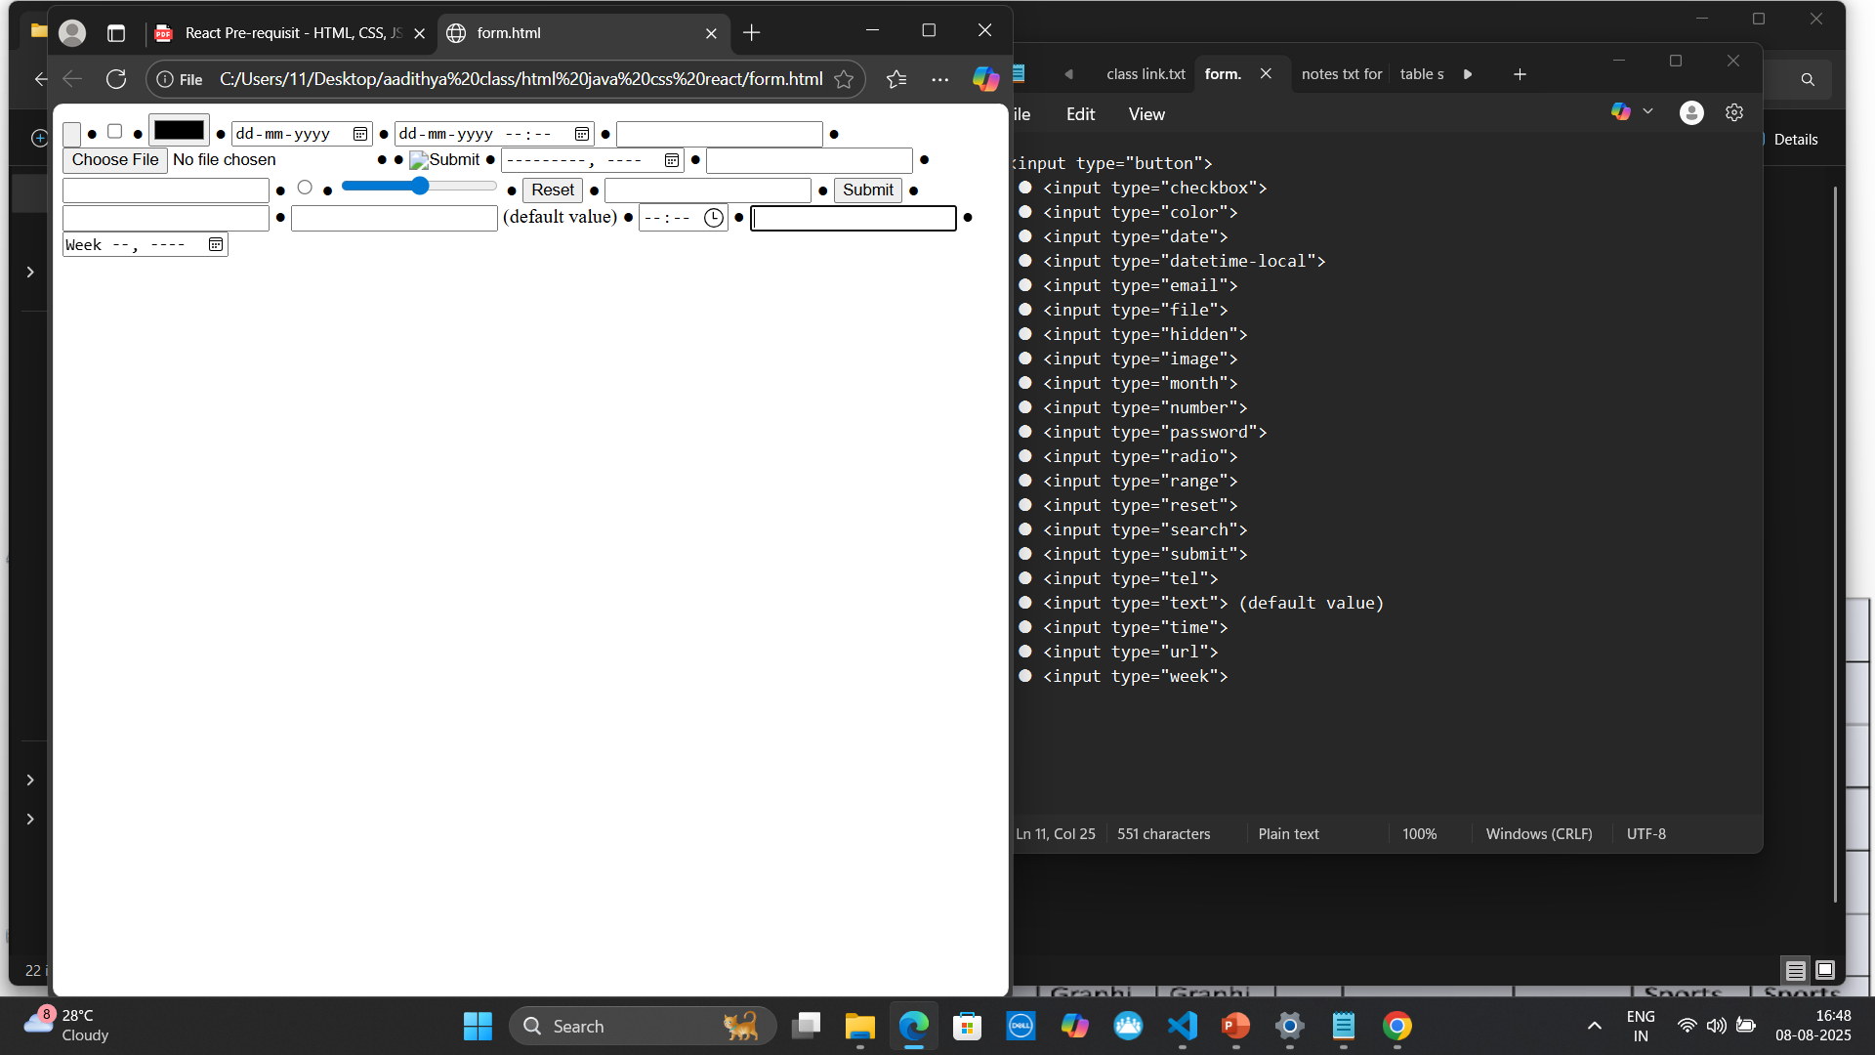

Slide 20
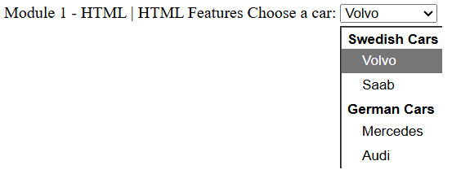
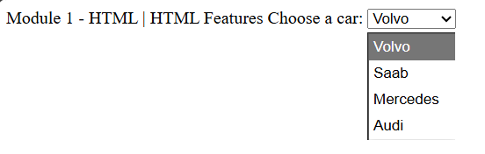
<label for="cars">Choose a car:</label>
<select name="cars" id="cars">
<optgroup label="Swedish Cars">
<option value="volvo">Volvo</option>
<option value="saab">Saab</option>
</optgroup>
<optgroup label="German Cars">
<option value="mercedes">Mercedes</option>
<option value="audi">Audi</option>
</optgroup>
</select>
<label for="cars">Choose a car:</label>
<select name="cars" id="cars">
<option value="volvo">Volvo</option>
<option value="saab">Saab</option>
<option value="mercedes">Mercedes</option>
<option value="audi">Audi</option>
</select>
See the 2 groups Swedish and
Germa

Slide 21
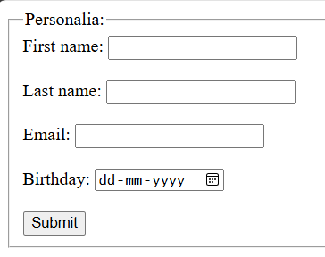
<fieldset>
<legend>Personalia:</legend>
<label for="fname">First name:</label>
<input type="text" id="fname" name="fname"><br><br>
<label for="lname">Last name:</label>
<input type="text" id="lname" name="lname"><br><br>
<label for="email">Email:</label>
<input type="email" id="email" name="email"><br><br>
<label for="birthday">Birthday:</label>
<input type="date" id="birthday" name="birthday"><br><br>
<input type="submit" value="Submit">
</fieldset>

Slide 23
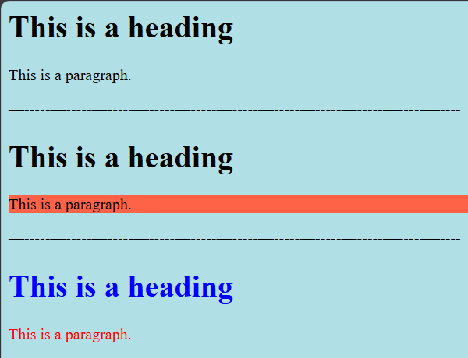
<body style="background-color:powderblue;">
<h1>This is a heading</h1>
<p>This is a paragraph.</p>
</body>
—-----—-----—-----—-----—-----—-----—-----—-----—-----—-----—----
<body>
<h1 style="background-color:powderblue;">This is a heading</h1>
<p style="background-color:tomato;">This is a paragraph.</p>
</body>
—-----—-----—-----—-----—-----—-----—-----—-----—-----—-----—----
<h1 style="color:blue;">This is a heading</h1>
<p style="color:red;">This is a paragraph.</p>

Slide 24
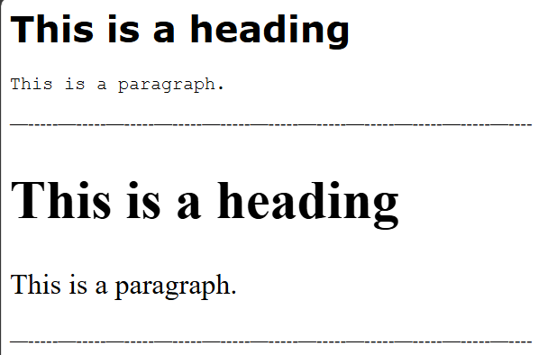

<h1 style="font-family:verdana;">This is a heading</h1>
<p style="font-family:courier;">This is a paragraph.</p>
—-----—-----—-----—-----—-----—-----—-----—-----—-----—-----—----
<h1 style="font-size:300%;">This is a heading</h1>
<p style="font-size:160%;">This is a paragraph.</p>
—-----—-----—-----—-----—-----—-----—-----—-----—-----—-----—----
<h1 style="text-align:center;">Centered Heading</h1>
<p style="text-align:center;">Centered paragraph.</p>

Slide 25
Formatting elements were designed
to display special types of text:
Elements:
<b> - Bold text
<strong> - Important text
<i> - Italic text
<em> - Emphasized text
<mark> - Marked text
<small> - Smaller text
<del> - Deleted text
<ins> - Inserted text
<sub> - Subscript text
<sup> - Superscript text

Slide 26
<b>This text is bold</b>
<strong> - Important text. The HTML <strong> element defines text with strong importance. The
content inside is typically displayed in bold.
Example:
<strong>This text is important!</strong>
<i> - Italic text. The HTML <i> element defines a part of text in an alternate voice or mood. The content inside is typically displayed in italic. The <i> tag is often used to indicate a technical term, a phrase from another language, a thought, a ship name, etc.
<em> - Emphasized text. The HTML <em> element defines emphasized text. The content inside is
typically displayed in italic. Tip: A screen reader will pronounce the words in <em> with an emphasis, using verbal stress.
<i>This text is italic</i>
<em>This text is emphasized</em>
<small> - Smaller text. The HTML <small> element defines smaller text
<small>This is some smaller text.</small>
<mark> - Marked text. The HTML <mark> element defines text that should be marked or highlighted
<p>Do not forget to buy <mark>milk</mark> today.</p>
<del> - Deleted text. The HTML <del> element defines text that has been deleted from a document.
Browsers will usually strike a line through deleted text:

Slide 27
<b>This text is bold</b>
<strong> - Important text. The HTML <strong> element defines text with strong importance. The
content inside is typically displayed in bold.
Example:
<strong>This text is important!</strong>
<i> - Italic text. The HTML <i> element defines a part of text in an alternate voice or mood. The content inside is typically displayed in italic. The <i> tag is often used to indicate a technical term, a phrase from another language, a thought, a ship name, etc.
<em> - Emphasized text. The HTML <em> element defines emphasized text. The content inside is
typically displayed in italic. Tip: A screen reader will pronounce the words in <em> with an emphasis, using verbal stress.

Slide 28
<i>This text is italic</i>
<em>This text is emphasized</em>
<small> - Smaller text. The HTML <small> element defines smaller text
<small>This is some smaller text.</small>
<mark> - Marked text. The HTML <mark> element defines text that should be marked or highlighted
<p>Do not forget to buy <mark>milk</mark> today.</p>
<del> - Deleted text. The HTML <del> element defines text that has been deleted from a document.
Browsers will usually strike a line through deleted text:

Slide 29
<p>My favorite color is <del>blue</del> red.</p>
<ins> - Inserted text. The HTML <ins> element defines a text that has been inserted into a document. Browsers will usually underline inserted text:
<p>My favorite color is <del>blue</del> <ins>red</ins>.</p>
<sub> - Subscript text. The HTML <sub> element defines subscript text. Subscript text appears half a character below the normal line, and is sometimes rendered in a smaller font. Subscript text can be used for chemical formulas, like H2O:
<sup> - Superscript text. The HTML <sup> element defines superscript text. Superscript text appears half a character above the normal line, and is sometimes rendered in a smaller font. Superscript text can be used for footnotes, like WWW[1]:
<p>This is <sub>subscripted</sub> text.</p>
<p>This is <sup>superscripted</sup> text.</p>
<blockquote> - Quotations
<q> - short quotation.

Slide 30
<abbr> - abbreviation or acronym
<address> - contact information
<cite> - title of a creative work
<bdo> - BDO stands for Bi-Directional Override. override the current text direction
<blockquote> - Quotations
<q> - short quotation.
<abbr> - abbreviation or acronym
Example:

Slide 31
<p>Here is a quote from WWF's website:</p>
<blockquote cite="http://www.worldwildlife.org/who/index.html">
For 60 years, WWF has worked to help people and nature thrive. As the world's leading
conservation organization, WWF works in nearly 100 countries. At every level, we
collaborate with people around the world to develop and deliver innovative solutions
that protect communities, wildlife, and the places in which they live.
</blockquote>
<p>WWF's goal is to: <q>Build a future where people live in harmony with
nature.</q></p>
<p>The <abbr title="World Health Organization">WHO</abbr> was founded in 1948.</p>
<address> - contact information
<cite> - title of a creative work

Slide 32
<bdo> - BDO stands for Bi-Directional Override. override the current text direction
Example:
<address>
Written by John Doe.<br>
Visit us at:<br>
Example.com<br>
Box 564, Disneyland<br>
USA
</address>
<p><cite>The Scream</cite> by Edvard Munch. Painted in 1893.</p>
<bdo dir="rtl">This text will be written from right to left</bdo>
/

Slide 33
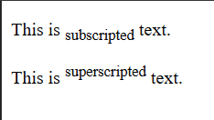
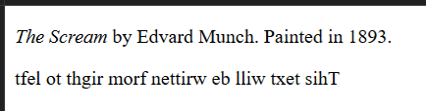
<p>This is <sub>subscripted</sub> text.</p>
<p>This is <sup>superscripted</sup> text.</p>
<p><cite>The Scream</cite> by Edvard Munch. Painted in 1893.</p>
<bdo dir="rtl">This text will be written from right to left</bdo>
<q> - short quotation.
<abbr> - abbreviation or acronym

